Slide 1
ICP Presentation -2
Group-2
-Yaswanth Paruchuri
-Tej Deep Parvatha Reddy

Slide 2
Introduction
Android studio – It’s a tool where we can perform the app development. Android software development is the process to create the applications for the devices that run on the android OS(operating system).
We can use any language for the development such as Java, Kotlin, C++ using the Android development kit.
Now the change in generations and the technology has rapidly grown where people use everything on mobile and 99% of tasks can be done on mobile.
Android is the most used OS in the world as most of the cell phones work with android and creating an app is easy compared to any other apps and it is user friendly.

Slide 3
Features
Open source
Create user interface for the Apps
Easy Navigation between pages
Inter app integration
Interacting with APIs for sending/receiving network requests
Rich Development environment

Slide 4
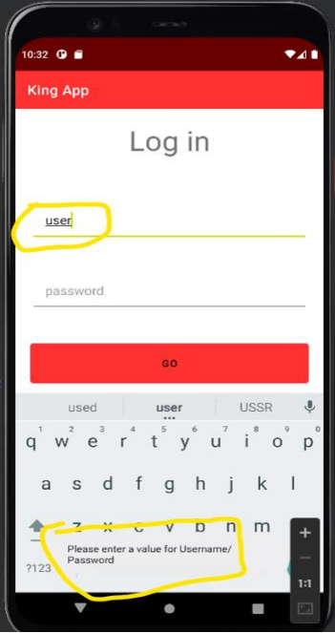
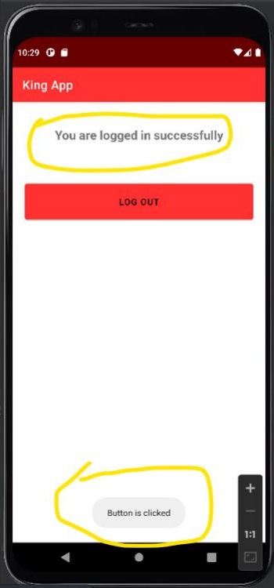
ICP-8
Create an android app and change the name of the app
Simple login screen with two input fields
Validation for the input data
Message display for every action performed

Slide 5
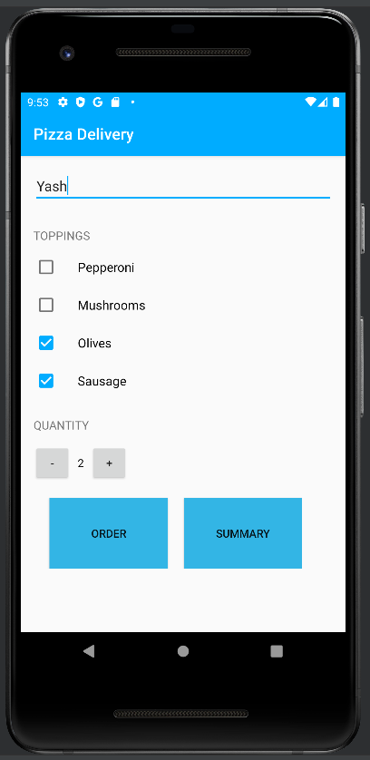
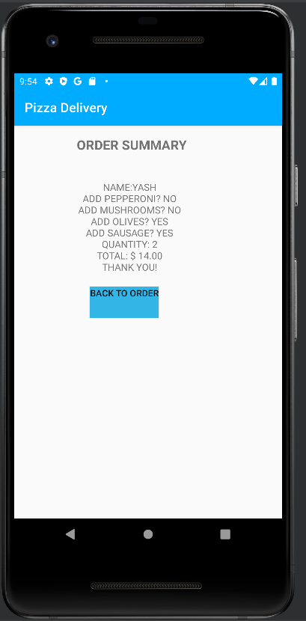
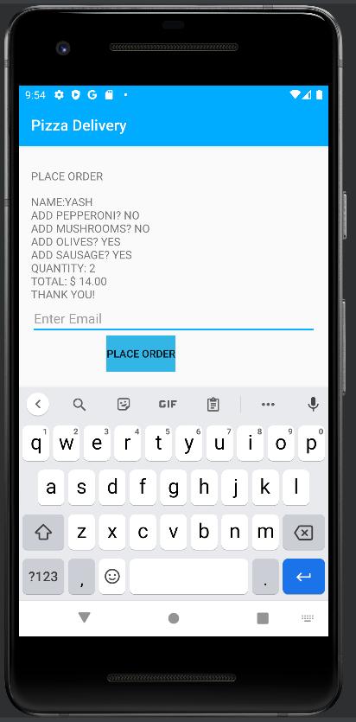
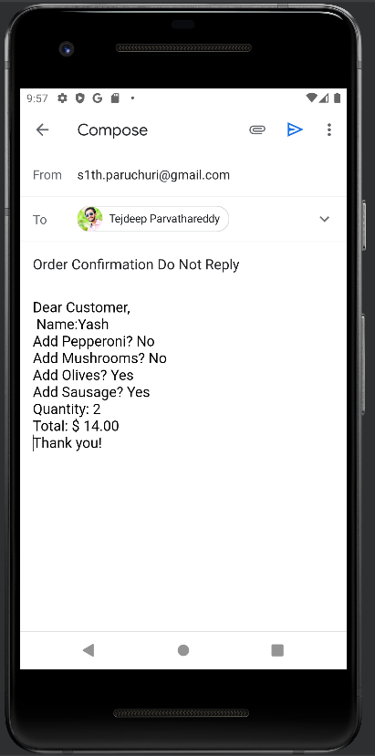
ICP-9
Input username and select the toppings
Displays the Order summary of the selected items with username
Place order by giving email as input
Open Email app with order summary with email given as recepient

Slide 6
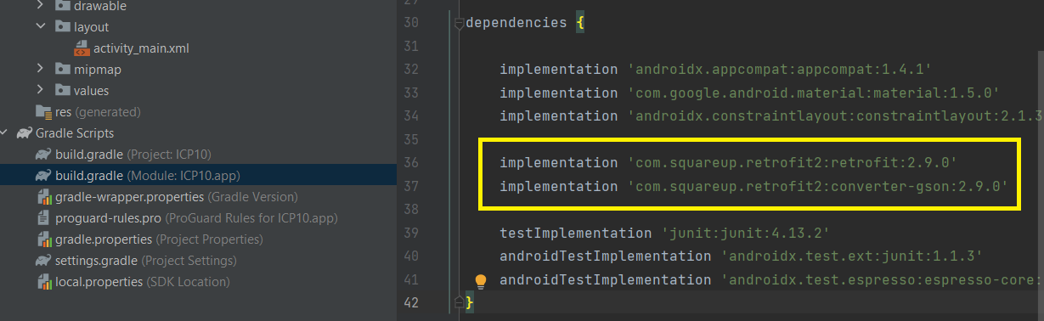
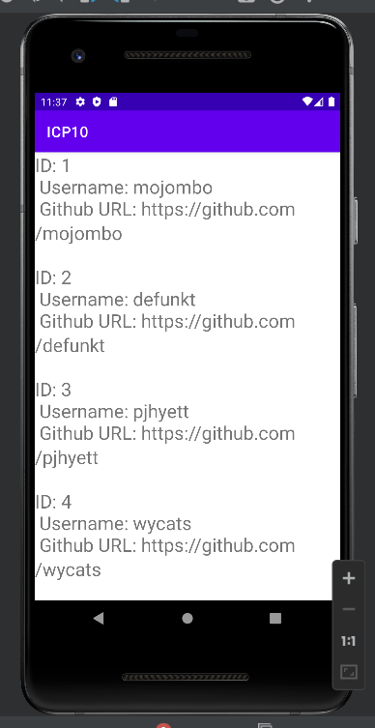
ICP-10
Using squareup retrofit service as the dependency for network requests to get the data from github/users and display them in UI

Slide 7
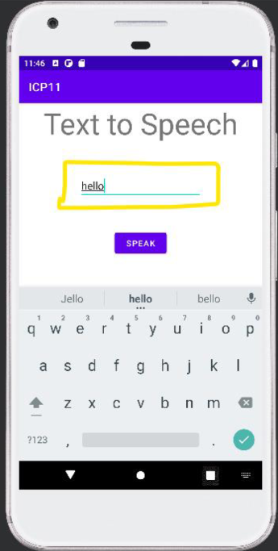
ICP-11
Simple Android app that has the Input text field and heading that will convert the text entered to speech.

Slide 8
Conclusion
We learned how to create interacting UI in Android apps using the Android studio
App integration with existing apps like Email
How to navigate between the pages created
Interacting with API for sending/ receiving the data using the network requests
Converting text to speech

Slide 9
Thank you ☺

